Slide 1
Rotten Tiger
Group 1
Jami Pietilä, Arton Ramadani, Kasperi Mustonen, Ville Pekkala

Slide 2
Projeckt overview
All team members worked across both frontend and backend. There were no strict roles, and tasks were shared flexibly within the team.
The team’s average working hours were approximately 60-70 hours.
During the project, we learned how to build a React based application. We also improved our understanding of application structure.
Team collaboration and communication were good and effective. The main challenges were the overall workload and designing logical solutions for how the website should function.

Slide 3
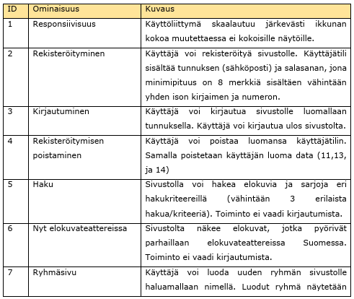
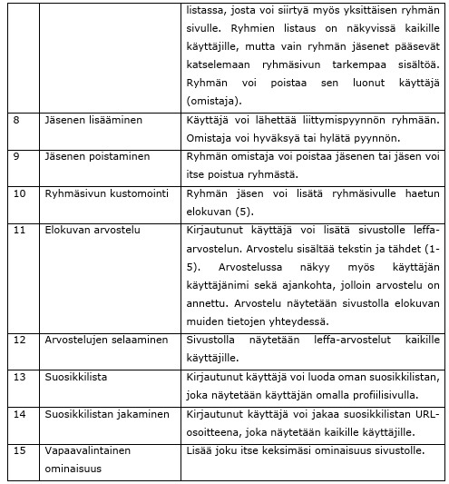
Features
We successfully implemented all the required features. As an optional feature, we created a Trending list for the website. We will now demonstrate how the website works and what the implementation looks like.

